Slide 1


From MapReduce to Graph
SE3331-1 (2022 Fall)
Yubin Xia
IPADS, Shanghai Jiao Tong University
https://www.sjtu.edu.cn
Credits: Rong Chen@IPADS, Aydin Buluc

Slide 2
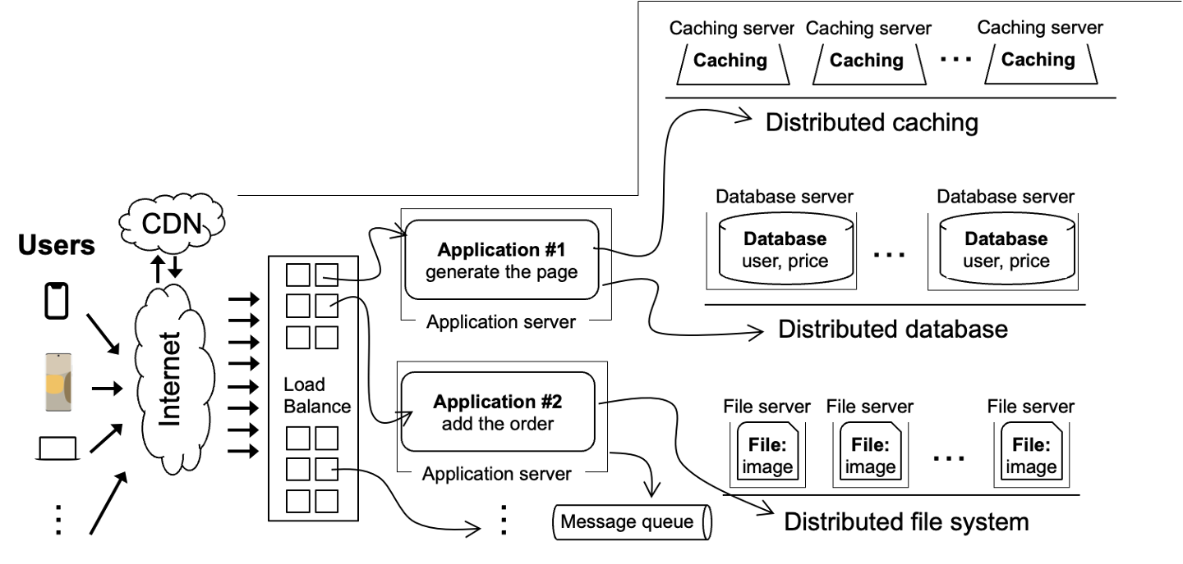
Scalable websites review
Scalable websites powered by distributed systems
  For request handling, data storage
Application #1
generate the page
requests
results
Application server

Slide 3

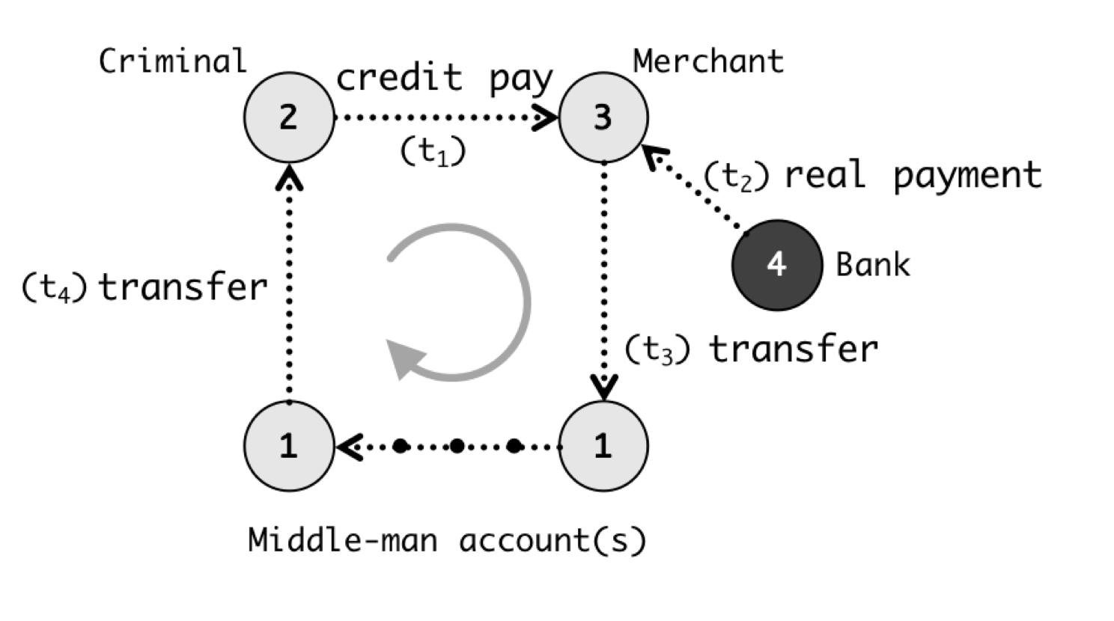

How does the application server handle requests?
For simple web page
  Application server’s framework (PHP) is sufficient
Complex queries are processed by powerful distributed computing frameworks
  Fraud detection -> Graph processing system
  Hot lists -> MapReduce
Online vs. offline
  Online: compute the requests based on requests
  Offline: return the pre-computed results
Render the page
Alipay detects frauds w/ graph systems
Generate hot lists

Slide 4
How does the application server handle requests?
For simple web page
  Application server’s framework (PHP) is sufficient
Complex queries are processed by powerful distributed computing frameworks
  Fraud detection -> Graph processing system
  Hot lists -> MapReduce
Online vs. offline
  Online: compute triggered by the user requests
  Offline: return the pre-computed results
Render the page
Alipay detects frauds w/ graph systems
Generate hot lists

Slide 5


Review: batch processing systems
A batch processing system takes a large amount of input data
  Computing takes a while（from minutes~ days）, and thus offline
  run periodically （e.g., generate hot lists every day ）
  Key performance metric: throughput
Examples:
  Spark
  MapReduce
  Hadoop
  etc.

Slide 6
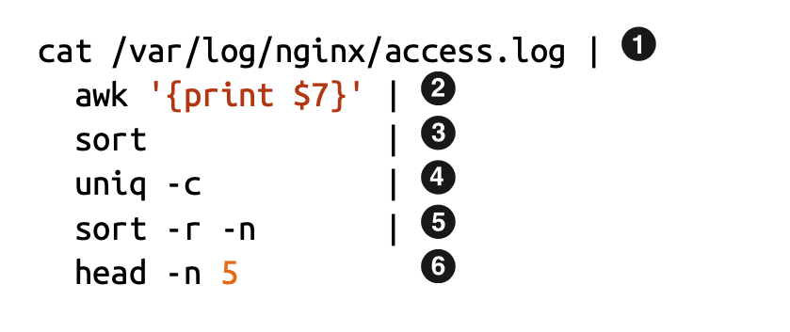
Review: accelerate batch processing w/ distributed computing
Distributed computing
  Split data into equal-size chunks
  Each process can work on a chunk parallelly
Challenges
  Identify concurrency
  Not all problems can be parallelized (e.g., dependencies)
Task/Data that can be processed concurrently
4
depends on
3

Slide 7
Review of MapReduce
Created by Google (OSDI’04)
  Jeffrey Dean and Sanjay Ghemawat
Inspired by LISP (function language)
  Map (function, set of values)
    Applies function to each value in the set
  Reduce (function, set of values)
    Combines all the values using a function (e.g., +)
      (map ‘length’ (() (a) (a b) (a b c))) → (0 1 2 3)
      (reduce #‘+’ (1 2 3 4 5)) → 15

Slide 8
Review of MapReduce Programming Model
Allows user to process huge amounts of data on thousands of nodes
Framework for data-parallel computing
  Programmers get simple API
Users do not have to worry about handling:
  Parallelization
  Data distribution
  Load balancing
  Fault tolerance

Slide 9
Review: MapReduce cannot address all the issues
MapReduce was used to process webpage data collected by Google’s crawlers
  It would extract the links and metadata needed to search the pages, and determine the site’s PageRank
The process took around eight hours
  Results were moved to search servers
  This was done continuously
Web
crawlers
MapReduce
Migrate to
search server
~8 hours!

Slide 10
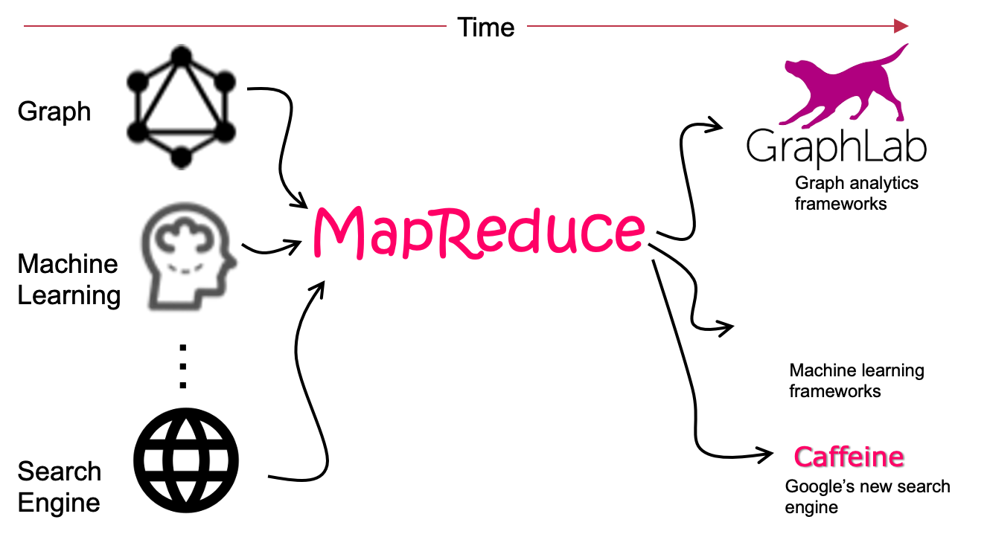


Graph-structured Analytics Systems
Graph
Graph analytics frameworks
MapReduce

Slide 11
Many Internet Applications are Graph-style

Slide 12




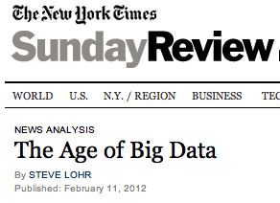
Big data is already here
6 Billion
Flickr Photos
1 Billion Tweets
Per Week
750 Million
Facebook Users
48 Hrs of Video
Per Minute
Big Learning
“…growing at 50 percent a year…”
“… data a new class of economic asset, like currency or gold.”

Slide 13



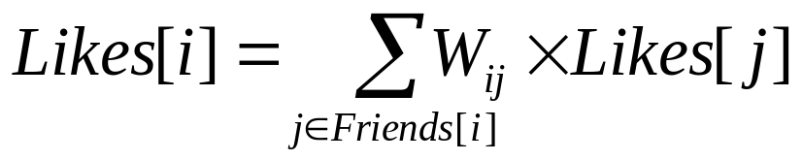

Big learning example
Label Propagation
Social Arithmetic
Sue Ann
50% What I list on my profile
40% Sue Ann Likes
10% Carlos Like
80% Cameras
20% Biking
40%
+
I Like:
60% Cameras, 40% Biking
Profile
50%
50% Cameras
50% Biking
Recurrence Algorithm
Me
Carlos
10%
30% Cameras
70% Biking
iterate until convergence
Parallelism: Compute all Likes[i] in parallel
Notes:
50*50 + 40*80 + 10*30
25+32+3=60

Slide 14
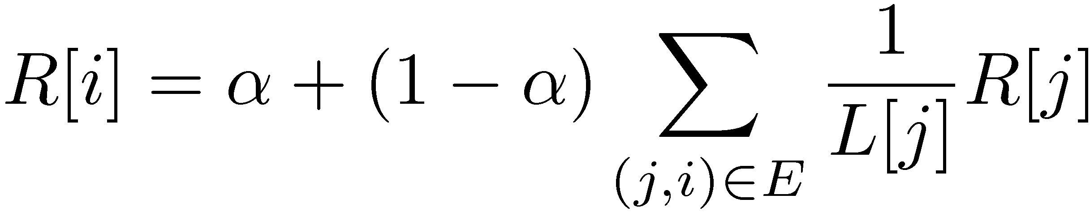
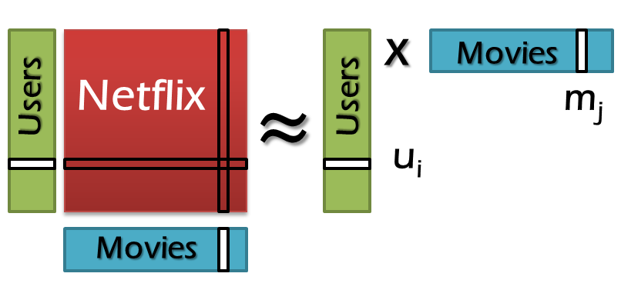
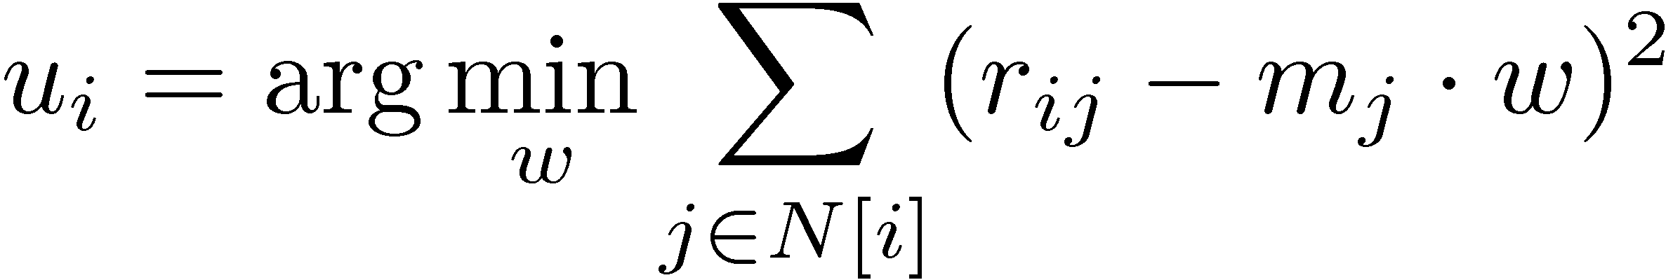
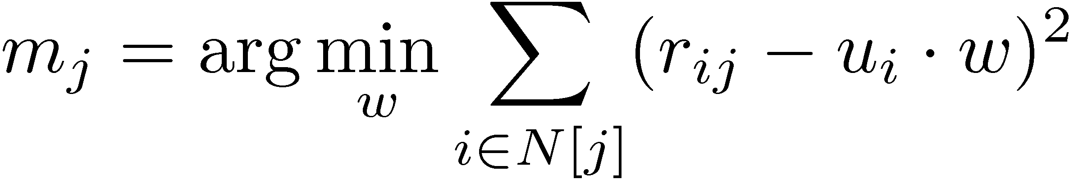
Big learning example
PageRank
http://ilpubs.stanford.edu:8090/422/1/1999-66.pdf
1
2
3
α is the random reset probability
L[j] is the number of links on page j
4
5
6
Alternating Least Squares
http://dl.acm.org/citation.cfm?id=1424269
Notes:
ALS：交替最小平方法，用于计算推荐矩阵

Slide 15
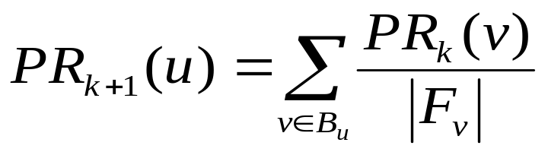
Example: PageRank
(if α = 0)
V₁
V₃
PR(u): Page Rank of node u
V₂
V₄
F_{u}: Out-neighbors of node u
Sergey Brin, Lawrence Page, “The Anatomy of Large-Scale Hypertextual Web Search Engine”, WWW ‘98

Slide 16
Example: PageRank
V₁
V₃
PR(u): Page Rank of node u
V₂
V₄
F_{u}: Out-neighbors of node u
 | K=0
PR(V₁) | 0.25
PR(V₂) | 0.25
PR(V₃) | 0.25
PR(V₄) | 0.25
Sergey Brin, Lawrence Page, “The Anatomy of Large-Scale Hypertextual Web Search Engine”, WWW ‘98

Slide 17
Example: PageRank
V₁
V₃
PR(u): Page Rank of node u
V₂
V₄
F_{u}: Out-neighbors of node u
 | K=0 | K=1
PR(V₁) | 0.25 | ???
PR(V₂) | 0.25
PR(V₃) | 0.25
PR(V₄) | 0.25
 | K=0
PR(V₁) | 0.25
PR(V₂) | 0.25
PR(V₃) | 0.25
PR(V₄) | 0.25
Sergey Brin, Lawrence Page, “The Anatomy of Large-Scale Hypertextual Web Search Engine”, WWW ‘98

Slide 18
Example: PageRank
0.25
V₁
V₃
0.12
0.12
V₂
V₄
 | K=0 | K=1
PR(V₁) | 0.25 | ???
PR(V₂) | 0.25
PR(V₃) | 0.25
PR(V₄) | 0.25
Sergey Brin, Lawrence Page, “The Anatomy of Large-Scale Hypertextual Web Search Engine”, WWW ‘98

Slide 19
Example: PageRank
0.25
V₁
V₃
0.12
0.12
V₂
V₄
 | K=0 | K=1
PR(V₁) | 0.25 | 0.37
PR(V₂) | 0.25
PR(V₃) | 0.25
PR(V₄) | 0.25
Sergey Brin, Lawrence Page, “The Anatomy of Large-Scale Hypertextual Web Search Engine”, WWW ‘98

Slide 20
Example: PageRank
V₁
V₃
V₂
V₄
 | K=0 | K=1 | K=2
PR(V₁) | 0.25 | 0.37 | 0.43
PR(V₂) | 0.25 | 0.08 | 0.12
PR(V₃) | 0.25 | 0.33 | 0.27
PR(V₄) | 0.25 | 0.20 | 0.16

Slide 21
Example: PageRank
V₁
V₃
Iterative Batch Processing
V₂
V₄
 | K=0 | K=1 | K=2
PR(V₁) | 0.25 | 0.37 | 0.43
PR(V₂) | 0.25 | 0.08 | 0.12
PR(V₃) | 0.25 | 0.33 | 0.27
PR(V₄) | 0.25 | 0.20 | 0.16

Slide 22
Example: PageRank
V₁
V₃
Convergence
Iterative Batch Processing
V₂
V₄
 | K=0 | K=1 | K=2 | K=3 | K=4 | K=5 | K=6
PR(V₁) | 0.25 | 0.37 | 0.43 | 0.35 | 0.39 | 0.39 | 0.38
PR(V₂) | 0.25 | 0.08 | 0.12 | 0.14 | 0.11 | 0.13 | 0.13
PR(V₃) | 0.25 | 0.33 | 0.27 | 0.29 | 0.29 | 0.28 | 0.28
PR(V₄) | 0.25 | 0.20 | 0.16 | 0.20 | 0.19 | 0.19 | 0.19

Slide 23
What are the features of
PageRank & Social Arithmetic

Slide 24
Graph Parallel Algorithm
2
2
4
4
3
3
My
Interests
7
7
1
1
6
6
Friends
Interests
4
4
Dependency
Graph
Predictable
Updates
(good for
scheduling)
Iterative
Computation

Slide 25
What is the Right Tool for Graph-parallel ML？
Data-Parallel
Data-Parallel Graph-Parallel
MapReduce
MapReduce?
Cross
Validation
Feature
Extraction
Lasso
PageRank
Label Propagation
Kernel Methods
Computing Sufficient
Statistics
Tensor
Factorization
Belief
Propagation
Word counting
Neural
Networks
Deep Belief
Networks

Slide 26
Can we use MapReduce for graphs?

Slide 27
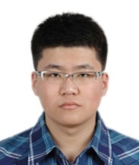






Step 0: prepare the data
Challenge: Difficult to express dependent data in MapReduce
  Issue#1: Substantial data transformations
  Issue#2: User-managed graph structure
  Issue#3: Costly data replication
MapReduce uses
Independent Data Records
But assume we have prepared the data

Slide 28
Storage layout of Graph using MapReduce
V₁
V₃
Each line of the file corresponds to a node in the graph
  id1 -> v1, id2 -> v2, etc.
  Why we store the ID?
    The ID may correspond to a concrete value, e.g., page
  PR(1), PR(2) … are the initial values of the page rank, e.g., 0.25
V₂
V₄
  (id₁, [PR(1), out₁₁, out₁₂, …]),
  (id₂, [PR(2), out₂₁, out₂₂, …]),
  ..

Slide 29
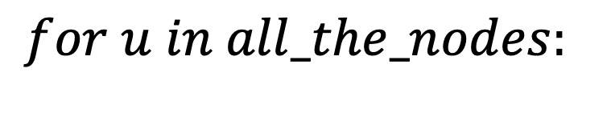

Using MapReduce to execute the page rank
$$for i in 0..k:$$
$$for u in all_the_nodes:$$

Slide 30
Goal
V₁
V₃
After the computation, output the final page rank
  For each node
  Input:
  (id₁, [PR(1), out₁₁, out₁₂, …]),
  (id₂, [PR(2), out₂₁, out₂₂, …]),
  ..
  Output:
  (id₁, [PR(1), out₁₁, out₁₂, …]),
  (id₂, [PR(2), out₂₁, out₂₂, …]),
V₂
V₄

Slide 31
Using MapReduce to execute the page rank
$$for i in 0..k:$$
$$for u in all_the_nodes:$$
For each iteration, we can simply implement it as a MapReduce job
  Map: emit the updates for its out-neighbours
  Reduce: sum up the results from the previous map

Slide 32
Step 1: The mapper
Map
  Input:
  (V1, [0.25, V2, V3, V4]);
  (V₂, [0.25, V₃, V₄]); (V₃, [0.25, V₁]);
  (V₄, [0.25, V₁, V₃])
  Output:
  (V2, 0.25/3), (V3, 0.25/3), (V4, 0.25/3),
  . . ., (V1, 0.25/2), (V3, 0.25/2);
  (V1, [V2, V3, V4]), (V2, [V3, V4]), (V3, [V1]), . . .
V₁
V₃
V₂
V₄

Slide 33
Step 1: The mapper
Map
  Input:
  (V1, [0.25, V2, V3, V4]);
  (V₂, [0.25, V₃, V₄]); (V₃, [0.25, V₁]);
  (V₄, [0.25, V₁, V₃])
  Output:
  (V2, 0.25/3), (V3, 0.25/3), (V4, 0.25/3),
  . . ., (V1, 0.25/2), (V3, 0.25/2);
  (V1, [V2, V3, V4]), (V2, [V3, V4]), (V3, [V1]), . . .
V₁
V₃
V₂
V₄

Slide 34
Step 2: shuffle the results (sorting)
Map
  Input:
  (V1, [0.25, V2, V3, V4]);
  (V₂, [0.25, V₃, V₄]); (V₃, [0.25, V₁]);
  (V₄, [0.25, V₁, V₃])
  Output:
  (V2, 0.25/3), (V3, 0.25/3), (V4, 0.25/3),
  . . ., (V1, 0.25/2), (V3, 0.25/2);
  (V1, [V2, V3, V4]), (V2, [V3, V4]), (V3, [V1]), . . .
V₁
V₃
V₂
V₄
Shuffle
  Output:
  (V1, 0.25/2), (V1, 0.25/1), (V1, [V2, V3, V4]); . . .;
  (V4, 0.25/3), (V4, 0.25/2), (V4, [V1, V3])

Slide 35
Step 3: Reduce
Map
  Input:
  (V1, [0.25, V2, V3, V4]);
  (V₂, [0.25, V₃, V₄]); (V₃, [0.25, V₁]);
  (V₄, [0.25, V₁, V₃])
  Output:
  (V2, 0.25/3), (V3, 0.25/3), (V4, 0.25/3),
  . . ., (V1, 0.25/2), (V3, 0.25/2);
  (V1, [V2, V3, V4]), (V2, [V3, V4]), (V3, [V1]), . . .
V₁
V₃
V₂
V₄
Shuffle
  Output:
  (V1, 0.25/2), (V1, 0.25/1), (V1, [V2, V3, V4]); . . .;
  (V4, 0.25/3), (V4, 0.25/2), (V4, [V1, V3])
Reduce
  Output:
  (V1, [0.37, V2, V3, V4]); (V2, [0.08, V3, V4]); (V3, [0.33, V1]); . .

Slide 36
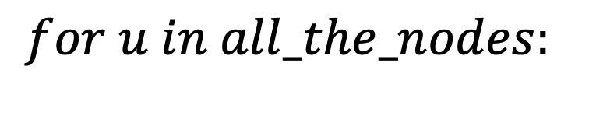

Using MapReduce to execute the page rank
Question: how to do the iteration?
$$for i in 0..k:$$
V₁,[0.25, V₂, V₃, V₄]
V₂,[0.25, V₃, V₄]
V₃,[0.25, V₁]
V₄,[0.25, V₁, V₃]
Input:
$$for u in all_the_nodes:$$
One MapReduce iteration
V₁,[0.37, V₂, V₃, V₄]
V₂,[0.08, V₃, V₄]
V₃,[0.33, V₁]
V₄,[0.20, V₁, V₃]
For each iteration, we can simply implement it as a MapReduce job
  Map: emit the updates for its out-neighbours
  Reduce: sum up the results from the previous map

Slide 37
Question: how to express the iteration?
$$for i in 0..k:$$
$$for u in all_the_nodes:$$
Can we express the iteration inside the mapper?
  Suppose we have a MRPageRankOne() implemented as a MapReduce job

Slide 38
Question: how to express the iteration?
Express the iteration inside the mapper?
  Suppose we have a MRPageRankOne() implemented as a MapReduce job
Map
i = 0
while i < k {
i += 1;
do MRPageRankOne();
}
emit all the results
Reduce
do nothing
We cannot execute a MapReduce job inside a map, why?
Because Map should be stateless, but MRPageRankOne is not idempotent

Slide 39
Solution: Multiple MapReduce iterations
The client (user) calls the MapReduce iteratively
Each PageRank iteration:
  Input:
  (id₁, [PR_{t}(1), out₁₁, out₁₂, …]),
  (id₂, [PR_{t}(2), out₂₁, out₂₂, …]),
  ..
  Output:
  (id₁, [PR_{t+1}(1), out₁₁, out₁₂, …]),
  (id₂, [PR_{t+1}(2), out₂₁, out₂₂, …]),
V₁
V₃
V₂
V₄
V₁,[0.25, V₂, V₃, V₄]
V₂,[0.25, V₃, V₄]
V₃,[0.25, V₁]
V₄,[0.25, V₁, V₃]
Input:
One MapReduce iteration
Iterate until convergence
V₁,[0.37, V₂, V₃, V₄]
V₂,[0.08, V₃, V₄]
V₃,[0.33, V₁]
V₄,[0.20, V₁, V₃]
Output

Slide 40
However: Iterative computing is difficult for MapReduce
MapReduce runtime is not optimized for iteration
  Persistent I/O (e.g., GFS)
Should tolerate failure between iterations (not implemented in MR)
Time
Data
Data
Map
Reduce
Map
Reduce
Data
Data
Data
Map
Reduce
Map
Reduce
Startup Penalty
Disk Penalty
Startup Penalty
Disk Penalty
Data
Data
Map
Reduce
Data
Data
Data
Map
Reduce
Map
Reduce
Data

Slide 41
Short summary of Drawbacks of MapReduce on Graph
No support for graph storage
  Using file adds many intermediate data transferred (and storage overhead)
No support for iterative processing
  Huge overhead in invocation for each MapReduce job
  No fault tolerant support
  Question
    Does Dryad help?
    No! Dryad’s computation graph is acyclic!

Slide 42
What is the Right Tool for Graph-parallel ML？
Data-parallel vs. MPI/PThreads
Data-Parallel Graph-Parallel
Map Reduce
Pthreads/MPI
MapReduce
Cross
Validation
Feature
Extraction
Lasso
PageRank
Label Propagation
Kernel Methods
Computing Sufficient
Statistics
Tensor
Factorization
Belief
Propagation
Neural
Networks
Deep Belief
Networks

Slide 43
Pthread and MPI
Pthread
  A common library to start multiple threads
  Threads can communicate with shared memory
MPI (Message passing interface)
  Frameworks for starting multiple processes across a set of nodes
    Each process can be multi-threaded
  Processes can send messages to each other with its APIs
  Provide some high-level communication primitives other than RPC

Slide 44
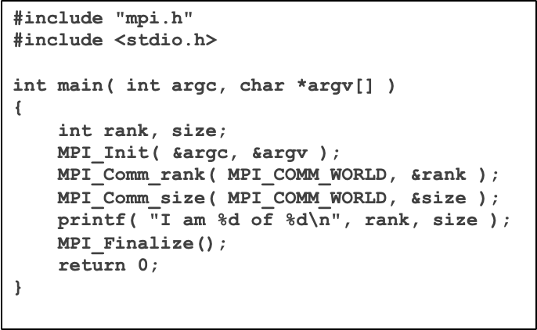

Hello world in MPI
a.out
#include "mpi.h"
#include <stdio.h>
int main( int argc, char *argv[] )
{
int rank, size;
MPI_Init( &argc, &argv );
MPI_Comm_rank( MPI_COMM_WORLD, &rank );
MPI_Comm_size( MPI_COMM_WORLD, &size );
printf( "I am %d of %d\n", rank, size );
MPI_Finalize();
return 0;
}
I am 0 of 4
I am 2 of 4
I am 3 of 4
I am 1 of 4
mpirun –np 4 a.out
  MPI_Comm_size reports the number of processes.
  MPI_Comm_rank reports the rank, a number between 0 and size-1, identifying the calling process

Slide 45
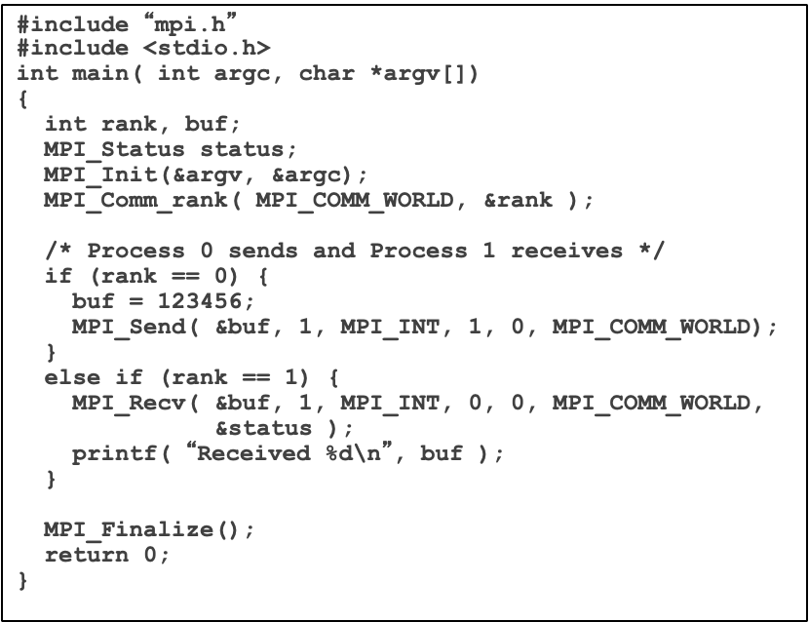
Sending & Receive messages in MPI
0
#include “mpi.h”
#include <stdio.h>
int main( int argc, char *argv[])
{
int rank, buf;
MPI_Status status;
MPI_Init(&argv, &argc);
MPI_Comm_rank( MPI_COMM_WORLD, &rank );
/* Process 0 sends and Process 1 receives */
if (rank == 0) {
buf = 123456;
MPI_Send( &buf, 1, MPI_INT, 1, 0, MPI_COMM_WORLD);
}
else if (rank == 1) {
MPI_Recv( &buf, 1, MPI_INT, 0, 0, MPI_COMM_WORLD,
&status );
printf( “Received %d\n”, buf );
}
MPI_Finalize();
return 0;
}
2
123456
3
1
Question: why combines type with data?
Notes:
Since all data is labeled by type, an MPI implementation can support communication between processes on machines with very different memory representations and lengths of elementary datatypes (heterogeneous communication).

Slide 46
Building PageRank atop of MPI & Pthread
Actually, much complex, we will not talk about details in this course
Challenges to consider
  How to store the graph in memory?
  How to partition the graph over multiple processors?
  How to coordinate between multiple processors?
    E.g., each machine typically wait others finish to go to the next iteration
Solving all of them is the same as building a new framework like MapReduce!

Slide 47
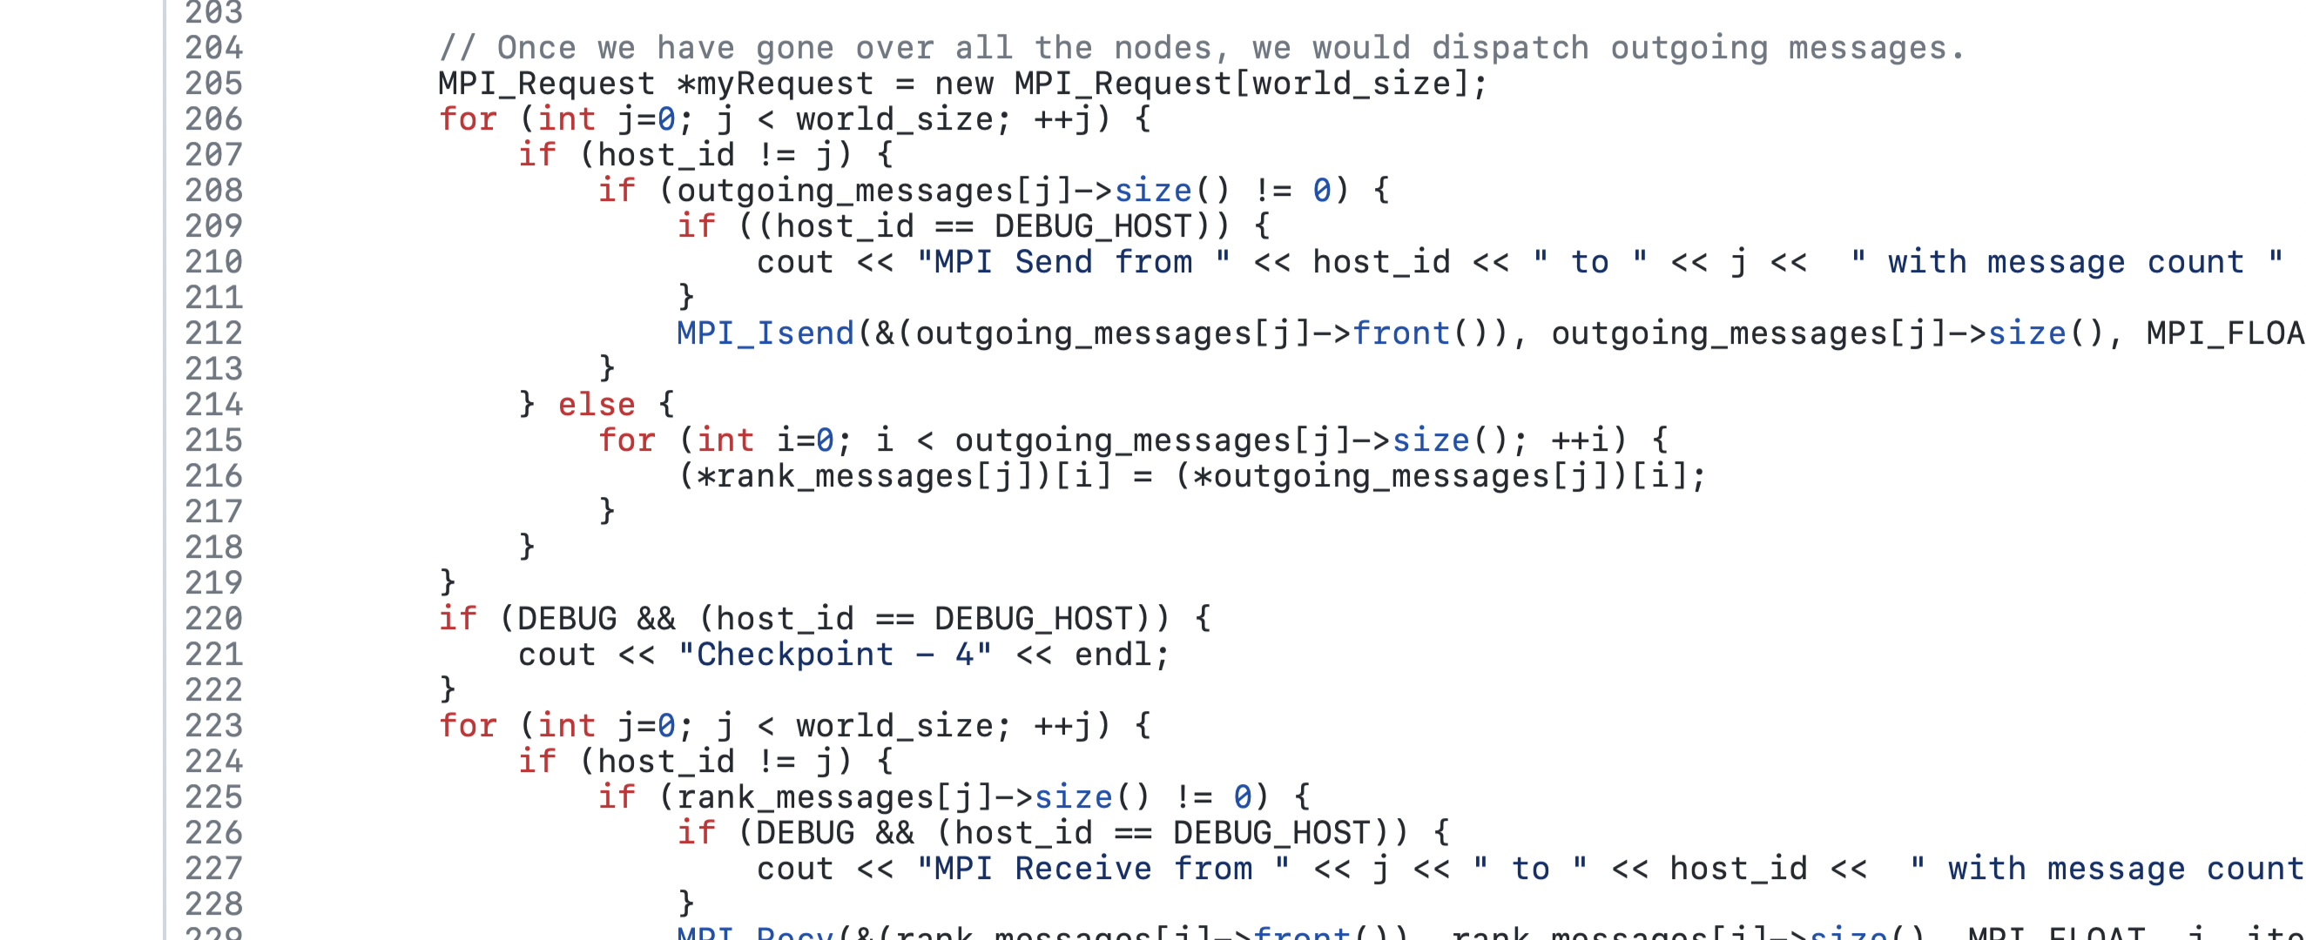
Building PageRank atop of MPI & Pthread
Source: https://github.com/gaurav324/PageRank-MPI
Send modifications from one iterations
How many LoC is necessary for MapReduce?
  < 100 LoC for the map & reduce
Further, no fault tolerant support or optimizations

Slide 48
Building PageRank atop of MPI & Pthread
ML experts repeatedly solve the same parallel design challenges
  Implement and debug complex parallel systems
  Tune for a specific parallel platform

Slide 49
Building PageRank atop of MPI & Pthread
Graduate Student
ML experts repeatedly solve the same parallel design challenges
  Implement and debug complex parallel systems
  Tune for a specific parallel platform
6 months later, a conference paper contains:
However, the resulting code will be difficult to maintain and extend
“We implemented ____ in parallel.”
couples learning model with parallel implementation

Slide 50
What is the Right Tool for Graph-parallel ML？
Friendly programming model
  Focus on application’s logic, instead of system-level details
  Many programmers have little system background
High performance
  High utilization of computing resource
  Less network transfer
Fault tolerance

Slide 51
What is the Right Tool for Graph-parallel ML？
Data-Parallel vs. Graph-Parallel
Data-Parallel Graph-Parallel
Graph-structured
Computation
Map Reduce
MPI/Pthreads
Cross
Validation
Feature
Extraction
Lasso
PageRank
Label Propagation
Kernel Methods
Computing Sufficient
Statistics
Tensor
Factorization
Belief
Propagation
Neural
Networks
Deep Belief
Networks

Slide 52
BSP and Pregel

Slide 53
Recall: Shortcomings of MapReduce
No support for graph storage
  Using file adds many intermediate data transferred (and storage overhead)
No support for iterative processing
  Huge overhead in invocation for each MapReduce job
Not (Graph) Friendly programming model
  Do not to write raw message transfers between processes
Fault tolerance
  Across iterations

Slide 54
GraphDB for storing the graph data
At each nodes, we directly store the graph in memory
  Store as in-memory key-value pairs (e.g., unordered_map)
    Key: vertex ID
    Value: edges (other vertex IDs), and etc. (node related data)
Coping w/ large graph: partitioning
  Partition the graph to multiple machines
  How?
  One way: Random: machine_id = hash(vertex_id) % num_workers
    Actually, graph partitioning is a complex problem, it is orthogonal to the content in this lecture

Slide 55
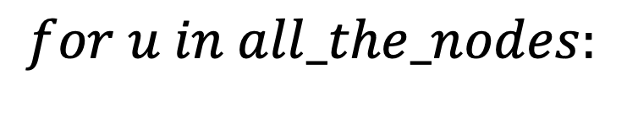
Benefits of using a GraphDB
Updates can be directly made in-pace in memory
  No need to generate intermediate files like in MapReduce
Example
  After receiving an update from a outgoing neighbors for id (via messaging, i.e., RPC), we can modify the page rank as:
    vertex[id].page_rank += new_updates
How users express this?
$$for u in all_the_nodes:$$

Slide 56
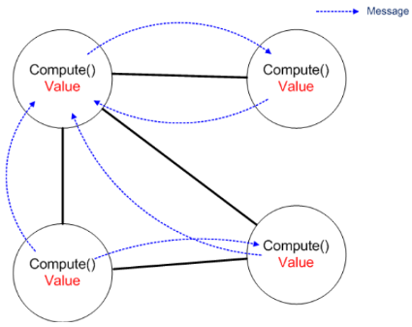
Vertex-centric programing of an iteration
Graph algorithms can be easily expressed as a vertex-centric programming:
Receives messages sent in the previous iteration
Executes the same user-defined function
Modifies its value
If active, sends messages to other vertices
(received in the next iteration)
Therefore, user only needs to provide a user-defined function!
Notes:
// 感觉inactive == 没有在传递的消息？

Slide 57
PageRank on Pregel
msgs: page_rank received from other neighbours
Class PageRankVertex {
public:
virtual void Compute(MessageIterator* msgs) {
if (superstep () >= 1) {
double sum = 0;
for (; !msgs->Done(); msgs->Next())
sum += msgs->Value();
}
*MutableValue() = 0.15/NumVertices() + 0.85*sum;}
}
Superstep: current iteration number

Slide 58
Question: how to do the computation iteratively?
At each iteration, we need
  Compute all the vertex’s page rank based on the previous iteration results (or set it to a new one)
  Only after all workers finish, we can start the next iteration

Slide 59

Bulk Synchronous Parallel Model
Compute
Communicate
Barrier

Slide 60
Put it all together: Pregel (Google, 2010)
Inspired by Valiant’s Bulk Synchronous Parallel (BSP) model
Communication through pure message-passing
  (usually sent along A the outgoing edges from each vertex)
Vertex-centric programming
  “Think like a vertex”
G. Malewicz et. al., “Pregel: A System for Large-Scale Graph Processing”, SIGMOD ‘10
Notes:
Pregel的三个技术点
Valiant 图灵奖得主

Slide 61
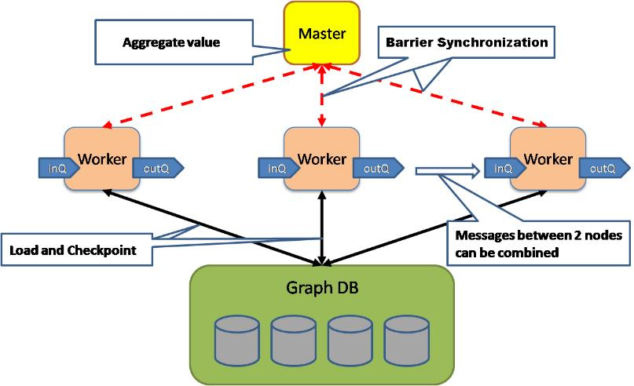

System Architecture of Pregel
Master-Slave architecture
Store a portion of the graph
GraphStore
GraphStore
GraphStore
A DB designed to store graph
orthogonal to Pregel
(no need to care in this lecture)

Slide 62
PageRank on Pregel
0.1
0.2
0.067
0.2
0.2
0.2
0.2
0.1
0.067
0.2
0.2
0.067
0.2
Superstep = 0

Slide 63
PageRank on Pregel
0.015
0.172
0.01
0.03
0.172
0.03
0.34
0.015
0.01
0.34
0.426
0.01
0.426
Superstep = 1

Slide 64
PageRank on Pregel
0.015
0.051
0.01
0.03
0.051
0.03
0.197
0.015
0.01
0.197
0.69
0.01
0.69
Superstep = 2

Slide 65
PageRank on Pregel
0.015
0.051
0.01
0.03
0.051
0.03
0.095
0.015
0.01
0.095
Computation converged
0.792
0.01
0.794
Superstep = 3

Slide 66
PageRank on Pregel
0.015
0.051
0.01
0.03
0.051
0.03
0.095
0.015
0.01
0.095
0.792
0.01
0.794
Superstep = 4

Slide 67
PageRank on Pregel
Superstep 0: PR value of each vertex 1/NumVertices()
Class PageRankVertex {
public:
virtual void Compute(MessageIterator* msgs) {
if (superstep () >= 1) {
double sum = 0;
for (; !msgs->Done(); msgs->Next())
sum += msgs->Value();
}
*MutableValue() = 0.15/NumVertices() + 0.85*sum;
if (superstep() < 30) {
const int64 n = GetOutEdgeIterator().size();
SendMessageToAllNeighbors(GetValue() / n);
} else {
VoteToHalt();
}
}
Set to 30 by experience
GetValue: get value set by MutableValue()

Slide 68
Vertex-centric programing of an iteration
In Vertex-centric programming, each vertex will:
Receives messages sent in the previous iteration
Executes the same user-defined function
Modifies its value
If active, sends messages to other vertices
(received in the next iteration)
Votes to halt if it has no further work to do → inactive
Terminate when all vertices are inactive and no messages in transmit
Notes:
// 感觉inactive == 没有在传递的消息？

Slide 69
PageRank on Pregel
Superstep 0: PR value of each vertex 1/NumVertices()
Class PageRankVertex {
public:
virtual void Compute(MessageIterator* msgs) {
if (superstep () >= 1) {
double sum = 0;
for (; !msgs->Done(); msgs->Next())
sum += msgs->Value();
}
*MutableValue() = 0.15/NumVertices() + 0.85*sum;
if (superstep() < 30) {
const int64 n = GetOutEdgeIterator().size();
SendMessageToAllNeighbors(GetValue() / n);
} else {
VoteToHalt();
}
}
Set to 30 by experience
GetValue: get value set by MutableValue()

Slide 70
What about fault tolerant?
Failure detection: master pings each worker periodically via heartbeat
  Similar in MapReduce
Failure handling
  Checkpointing: at the beginning of a superstep, checkpoint the graph data to a persistent storage (e.g., GFS)
  After failure, can recovery from checkpoint & re-compute
    For either worker or master
  The frequencies of checkpointing is determined by the mean time to failure
    Can measure MTTF in advance

Slide 71
Summary of Pregel
Bulk Synchronous Parallel (BSP) Model
  Message-passing model
  Better support for iterative computing
Use a GraphDB
  Applications do not need to manually transform the Graph data
Vertex-centric programming
  Natural to graph algorithms
  Reduce intermediate data
    Updates are directly sent between vertices

Slide 72
Problem#1: programming model can be more friendly
Message API is irreverent to the graph
Superstep 0: PR value of each vertex 1/NumVertices()
Class PageRankVertex {
public:
virtual void Compute(MessageIterator* msgs) {
if (superstep () >= 1) {
double sum = 0;
for (; !msgs->Done(); msgs->Next())
sum += msgs->Value();
*MutableValue() = 0.15/NumVertices() + 0.85*sum;
}
}

Slide 73
Problem#2: the issue of BSP
Example Algorithm: If Red neighbor then turn Red
Time 0
Time 1
Time 2
Time 3
Time 4

Slide 74
Problem#2: the issue of BSP
Example Algorithm: If Red neighbor then turn Red
Bulk Synchronous Parallel Computation :
  Evaluate condition on all vertices for every phase
  4 Phases each with 9 computations → 36 Computations
Solution: asynchronous Computation:
  Evaluate condition only when neighbor changes
  4 Phases each with 2 computations → 8 Computations
Time 0
Time 1
Time 2
Time 3
Time 4

Slide 75
Problem#2: the issue of BSP
performance is limited by the slowest machine
Data
Data
Data
Data
CPU 1
CPU 1
CPU 1
Data
Data
Data
Data
Data
Data
Data
Data
CPU 2
CPU 2
CPU 2
Data
Data
Data
Data
Data
Data
Data
Data
CPU 3
CPU 3
CPU 3
Data
Data
Data
Data
Data
Data
Data
Data
Barrier
Iterations
Barrier
Barrier

Slide 76
To solve problem-1:
Shared memory and GraphLab

Slide 77
Programming model: shared memory
Shared memory
  a user defined program which when applied to a vertex transforms the data in the scope of the vertex (scope is the set of all neighbor vertices)
void PageRank(scope){
// Get Neighborhood data
float sum = 0, diff;
float last = this.val;
foreach (nbr in scope.in_nbrs)
sum += nbr.val/nbr.nout_nbrs;
// Update the vertex data
this.val = 0.15 + 0.85*sum;
// Reschedule Nbrs if needed
diff = abs(this.val – last);
if (diff > epsilon)
reschedule(this.out_nbrs);
}

Slide 78
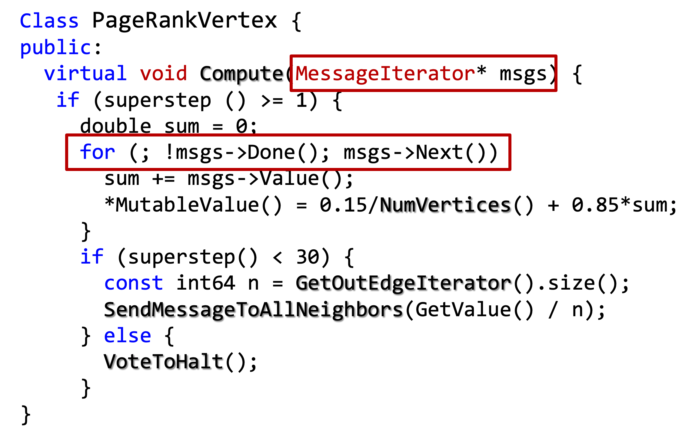
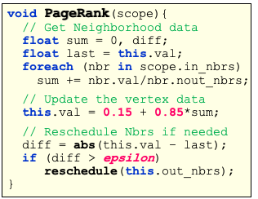
Message-passing vs. shared memory
Shared memory model has the following benefits:
  1. No messages managed by the user
  2. User does not need code to parse message

Slide 79
Problem: what if the neighbor is
at a remote machine?

Slide 80
Distributed Graph
Partition the graph across multiple machines

Slide 81
Distributed Graph
Ghost vertices maintain adjacency structure and replicate remote data
Problem: after remote vertices updates, should update ghost through network.
Should reduce cross-machine edges
ghost vertices

Slide 82
Distributed Graph
Cut efficiently using HPC Graph partitioning tools (e.g., ParMetis, …)
  Optimal partition is NP-hard
  Existing algorithms (e.g., ParMetis) provides good heuristics
ghost vertices

Slide 83
To solve problem-2:
How to accelerate BSP processing?
Async!

Slide 84
Async graph processing
Program only needs to add the vertex to a scheduler
  The scheduler will handle the scheduling

Slide 85
Asynchronous Scheduler
The scheduler determines the order that vertices are updated
CPU 1
b
c
d
a
b
c
Scheduler
e
f
b
e
f
g
a
i
h
i
j
h
i
j
k
CPU 2
The process repeats until the scheduler is empty
Notes:
if cycle, user needs to decide max iteration number

Slide 86
Asynchronous Scheduler
The choice of scheduler affects the correctness and parallel performance of the algorithm
GraphLab provides several different schedulers
  Vertices are updated
→ Round Robin, FIFO, Priority

Slide 87
Problem of async: race and race-free execution
Race: what happen if two UPDATE concurrently execute?
How much can computation overlap?
Notes:
The red part may see half old-data and half new-data.
note: BSP does not have this problem, since it's global.

Slide 88
Sequential Consistency
For each parallel execution, there exists
a sequential execution of update functions which produces the same result.
time
CPU 1
Parallel
CPU 2
Sequential
Single
CPU

Slide 89
Consistency through R/W Locks
Multicore Setting: R/W Locks
  Full consistency
  Users do not need to consider lock (done by the framework)
lock
Write
Write
Write
Canonical Lock Ordering

Slide 90
More Parallelism
Full Consistency
Edge Consistency
Vertex Consistency
We will talk about more race conditions in later lectures!
Notes:
Full consistency: worse perf.
Vertex consistency: better perf.

Slide 91
Summary: MapReduce vs. Pregel vs. GraphLab
Programming model
  MapReduce vs. Vertex-centric vs. Vertex-centric + update function
  General -> Friendly to graph -> Friendly to graph + optimizations
Execution model
  MapReduce vs. BSP vs. Async graph processing
  General -> suitable for iterative algorithms -> suitable for iterative algorithms + optimizations

